Slide 1
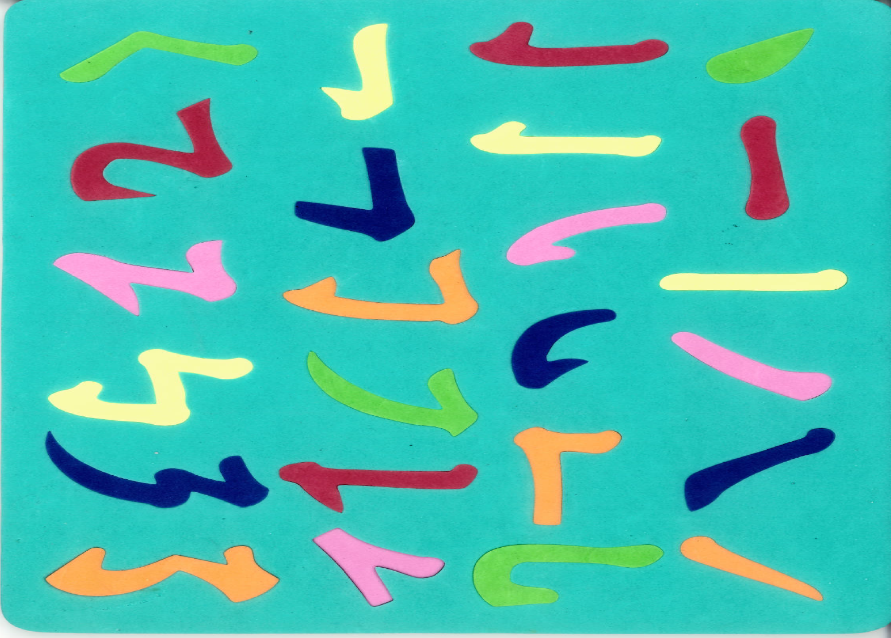
Basic Chinese Strokes and Radicals

Slide 5
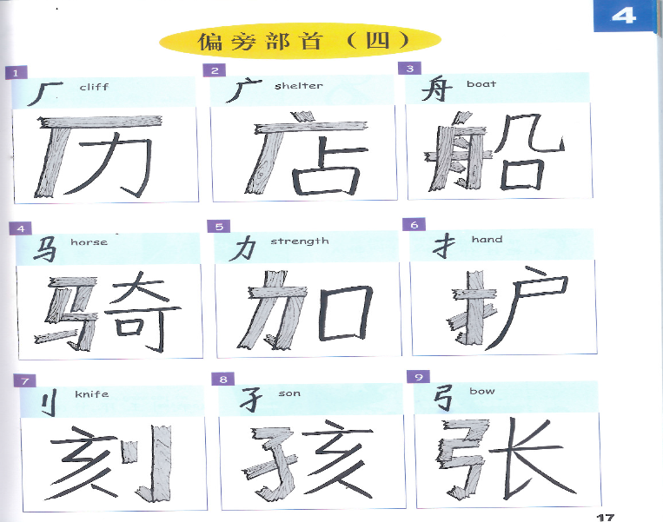

Slide 6
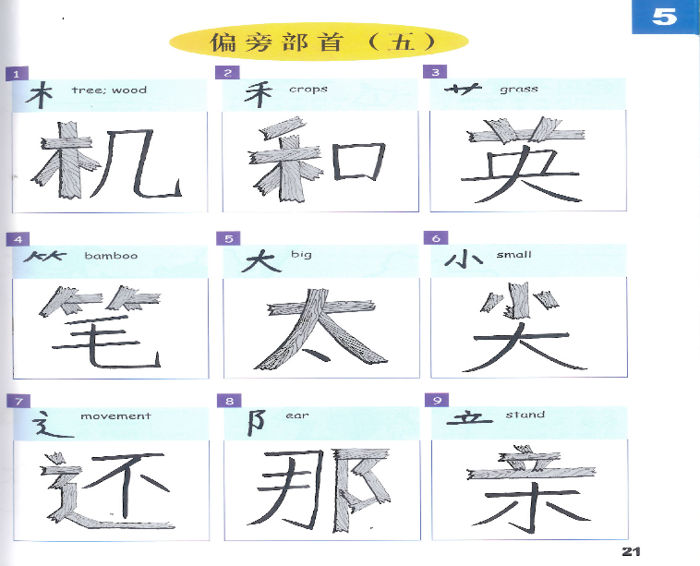

Slide 7
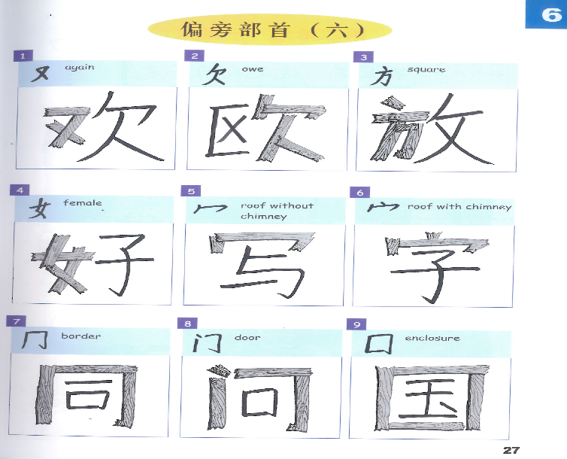

Slide 9
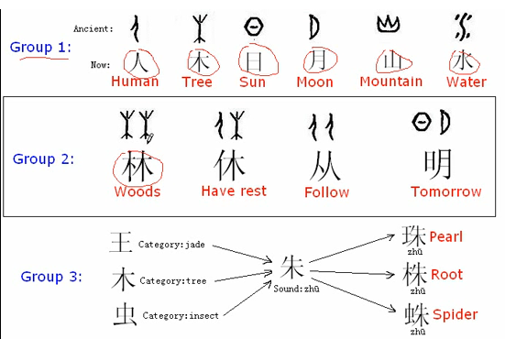

Slide 10
Part 1- Introduction to Chinese Characters:
http://www.youtube.com/watch?v=s0h18Rdhb44
2. Part 2A- Traditional Chinese Teaching Methodology:
http://www.youtube.com/watch?v=udlCJGQZkwM
3. Part 2B- ABCs of Chinese Teaching Methodology :
http://www.youtube.com/watch?v=5-qRr_lXps0
4. Part 3- The Importance of Learning Chinese:
http://www.youtube.com/watch?v=EIDC7gAyYFQ
5:An Introduction to Chinese Characters :
http://www.youtube.com/watch?v=qV517iT2x8o
6. History of Chinese characters:
http://www.youtube.com/watch?v=Df7BDBO6ubE&list=PL9C00D9D4A74BF13C
7. Simplified vs Traditional Chinese Characters | China Uncensored :
http://www.youtube.com/watch?v=Uc-H9XUarv8
8. 36 Chinese Characters:
http://www.youtube.com/watch?v=7VhOCX5WLpw
9. Part 1: Culture Shock - Chinese Americans in China :
http://www.youtube.com/watch?v=45Llkj58ujY
10. Part 2: Culture Shock - Chinese Americans in China :
http://www.youtube.com/watch?v=2c3BEO3Ggxg

Slide 11
11. Chinese characters-lesson 1 : http://www.youtube.com/watch?v=dO99C_VK-dc
12. Chinese characters-lesson 2 : http://www.youtube.com/watch?v=-dmlA8FXYLc
13. Chinese characters-lesson 3 : http://www.youtube.com/watch?v=H2Qop9VLBDk
14. Basic Chinese Radicals : http://www.youtube.com/watch?v=aVea79lZBq4
15. Chinese character stroke order rules :
http://www.youtube.com/watch?v=8MCnjfws0XQ
16. China. "Forbidden City", "Summer Palace", Beijing, Xian, Great Wall : http://www.youtube.com/watch?v=gdlTt54KMKM
17. Secrets of the Samurai Sword :
http://www.youtube.com/watch?v=LtulTGxJdDc
18. Secrets of China's Terracotta Warriors (Full Documentary) :
http://www.youtube.com/watch?v=8UJOcsCHyIQ

